Slide 1
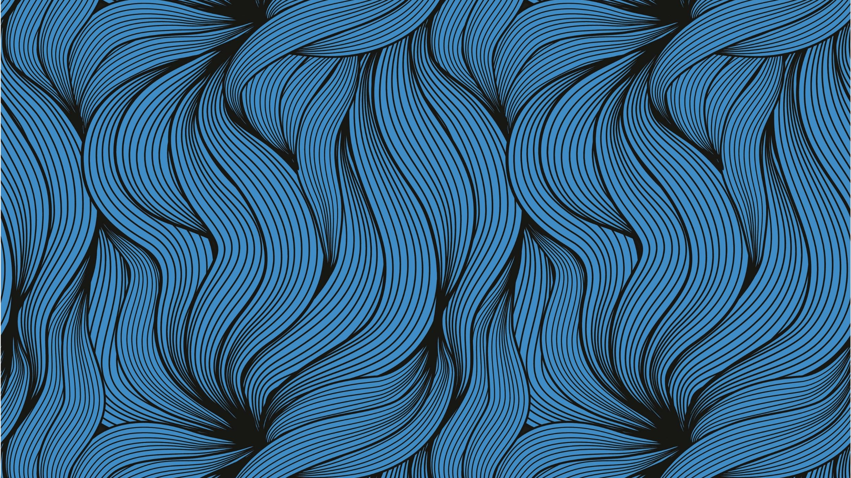
Convert normal image to sketch image using python
Falcon Infomatic

Slide 2
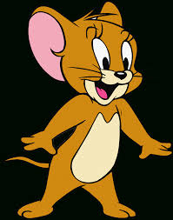
Input Image

Slide 3
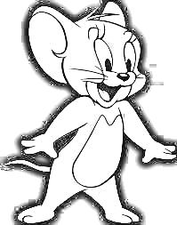
Output Image

Slide 4
Types of filter Used
Grey Filter
Inverted Filter
Blur Filter
Inverted Blur Filter

Slide 5
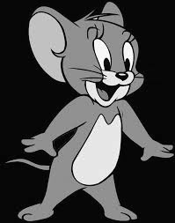
Grey Filter

Slide 6
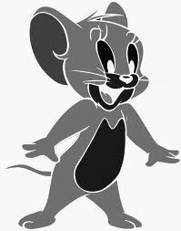
Inverted Filter

Slide 7
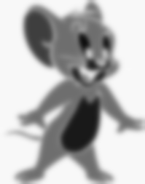
Blur Filter

Slide 8
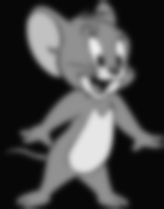
Inverted Blur Filter

